Slide 1
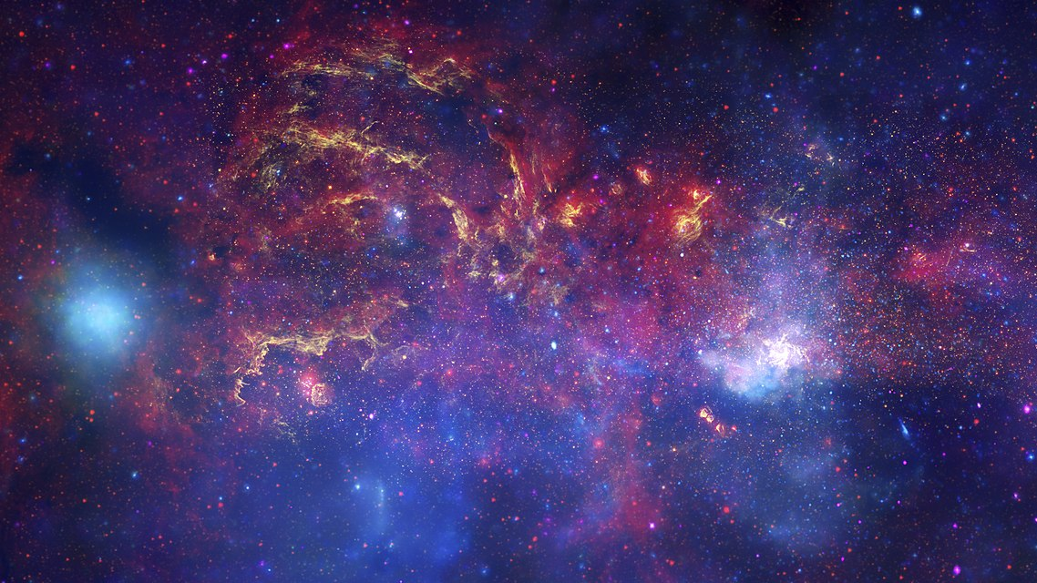
AI from Space using Azure
Global AI Bootcamp 2019
Christos Charmatzis
@christoscharmatzis
https://tageoforce.com
Athens, December 2019
Notes:
Welcome to the 1st Global AI Bootcamp 2019 in Athens.
Title of the presentation is “AI from Space using Azure”.
I am Christos Charmatzis and this is the center of our galaxy as the Hubble Space Telescope, the Spitzer Space Telescope, and the Chandra X-ray Observatory have producted.
[click]

Slide 2
Agenda
Introduce ourselves
Few things about AI
Earth Observation Data and where to find them
Choosing the right way with the right tools
Going to Azure for full power
Conclusions
Notes:
Introduce ourselves
Few things about AI
Earth Observation Data and where to find them
Choosing the right way with the right tools
Going to Azure for full power
Conclusions

Slide 3

Few things about me
Project manager @TA-Geoforce
GIS Specialist 10+ years
AI professional
Open Source enthusiasm
Piano player
Chopin – Heroic Polonaise
Source: youtube.com/Rouseau
Notes:
Project manager @TA-Geoforce a new establish company in Big Data analytics, AI solutions, Spatial Intelligence Solutions.
GIS Specialist 10+ years
AI professional
Open Source enthusiasm
Piano player
Chopin – Heroic Polonaise

Slide 4
What I used to say
A.I. is here
(I guess…)
Statistics
Data
Technology
Notes:
We all have here this so many times from so many people,
( I tell that because it’s nice to remember the high skills that we Data Scientists have!!!!)
that if we have 3 sets (circles) which are Data, Statistics and Technology
[click]
AI is the common space between them.
[click]
I guess and I say I guess because now days AI is more a brand name, that a scientific definition.
[click]

Slide 5
What’s AI for me
AI Knowledge
Data
All of us
Notes:
What’s AI for me
We can represent the whole process with an experiment bottle that we insert data in the form of liquids.
Attention, usually on element is not enough to get something, so we need more ingredients.
The AI is the bubbles or gas that gets out for experiment bottle and almost is equal with knowledge.
But to happen all that we need heat and the heat is all of us that we add energy to system so we can have fire.

Slide 6
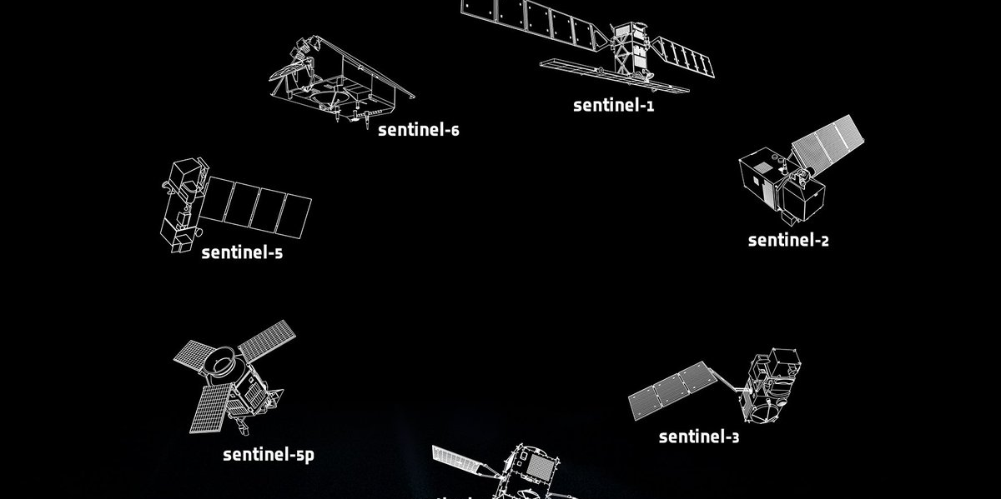
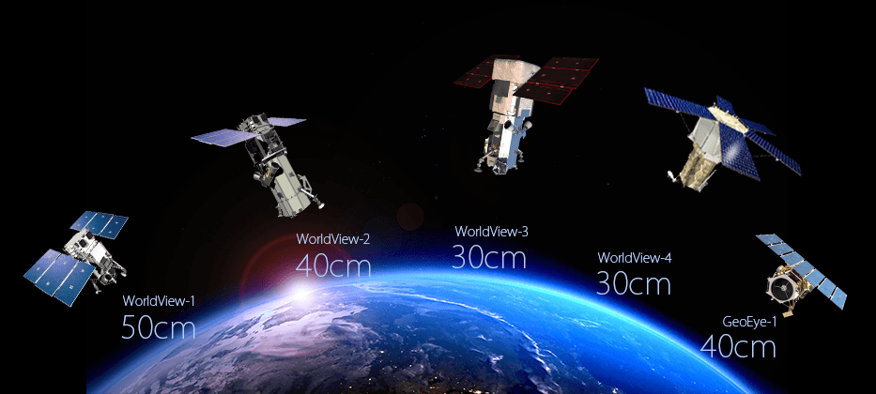
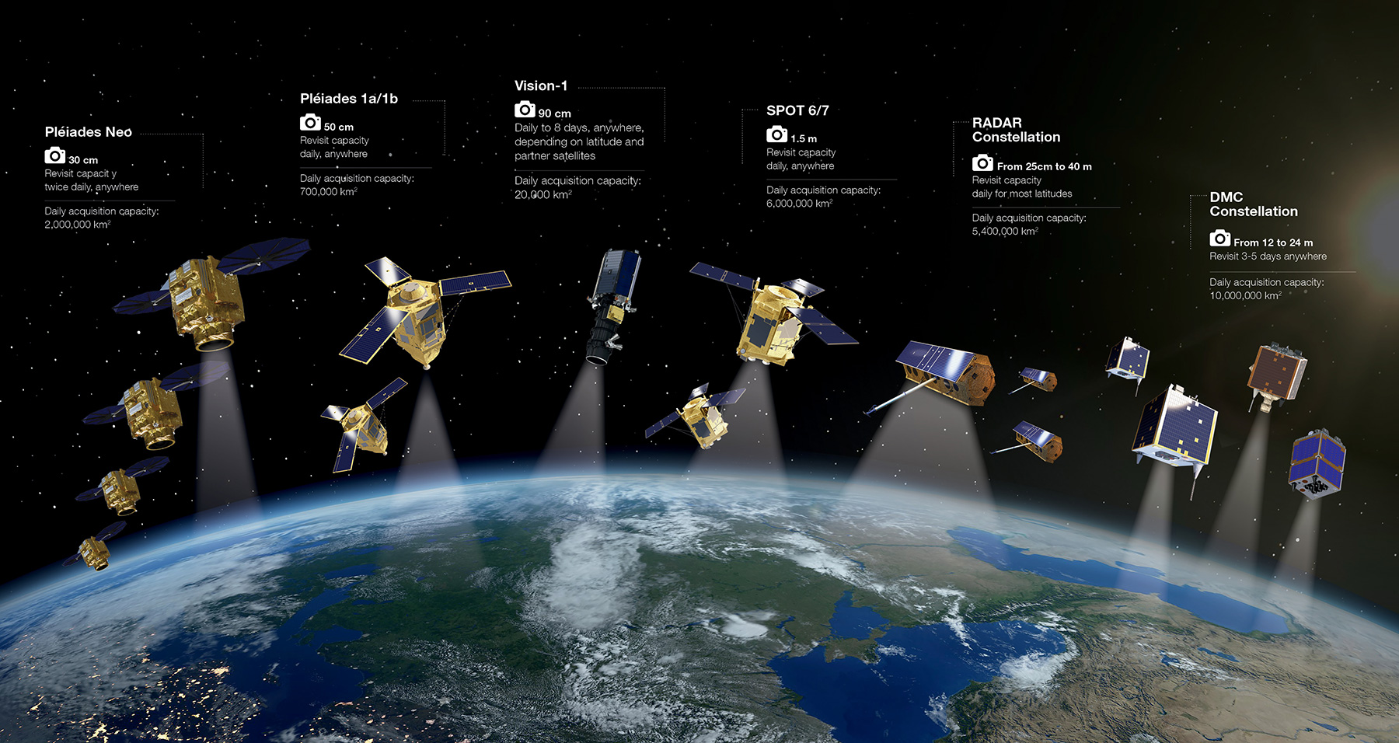
Data from Space
Refers to the massive spatio-temporal Earth and Space observation data collected by a variety of sensors - ranging from ground based to space-borne - and the synergy with data coming from other sources and communities.
Notes:
Data from Space
Refers to the massive spatio-temporal Earth and Space observation data collected by a variety of sensors - ranging from ground based to space-borne - and the synergy with data coming from other sources and communities.
In the three images we see the satellite from ESA top, WorldView middle (with resolution 30cm), and Airbus

Slide 7
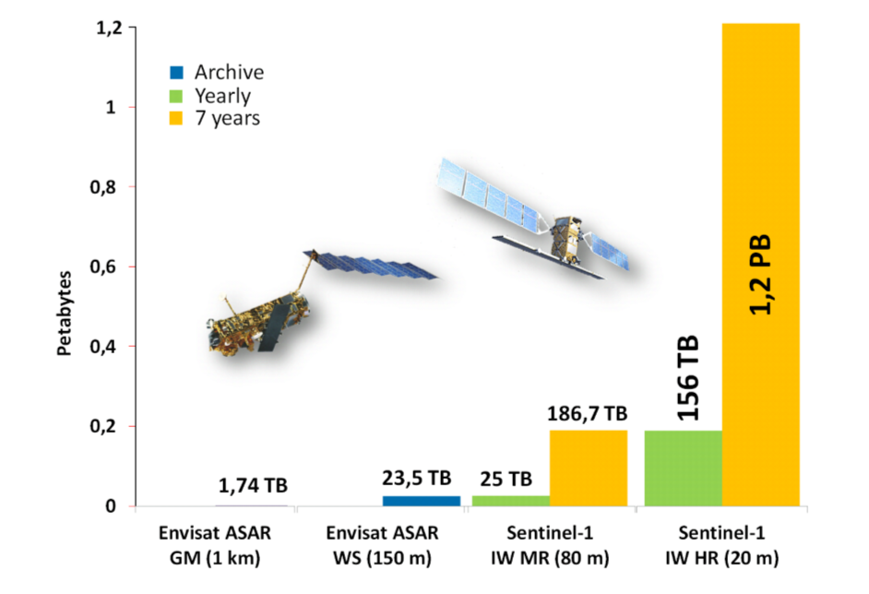
Earth Observation Data
Only ESA satellites produces around 150 terabytes per day!!
(source:https://www.esa.int/Applications/Observing_the_Earth/Working_towards_AI_and_Earth_observation )
Growth of data volume from ENVISAT ASAR to Sentinel-1.
Source: Big Data Infrastructures for Processing Sentinel Data - Wolfgang Wagner, Vienna - 2015
Notes:
Data from Space
Only ESA satellites produces around 150 terabytes per day!!
Sentinel 1 has reached 1,2 PB in 2015 data.

Slide 8
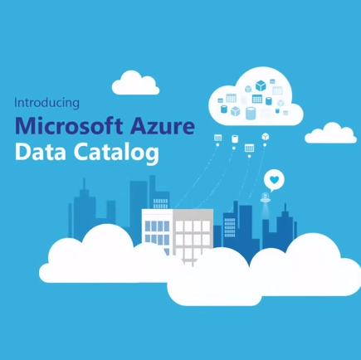
Did you know that Azure has an Open Data Catalogue?
MODIS
NAIP
NOAA Global Forecast System (GFS)
Harmonized Landsat Sentinel-2
NOAA Integrated Surface Data (ISD)
Daymet
And the best part is that are FREE OF CHARGE!
https://azure.microsoft.com/en-us/services/open-datasets/catalog
Notes:
Azure has an open data catalogue with big datasets, you can find this catalogue here
https://azure.microsoft.com/en-us/services/open-datasets/catalog
Did you know that 6 from 27 (22.2%) are earth observation and every day refresh data?
[go to https://azure.microsoft.com/en-us/services/open-datasets/catalog ]

Slide 9
The 1st step of AI project
Talk with the client about the goal of the AI project.
Split the question that needs to be answered in small questions.
Form the Team
Search for datasets
Notes:
Talk with the client about the goal of the AI project.
Split the question that needs to be answered in small questions.
Form the Team
Search for datasets

Slide 10
You just hit the wall
The problem in every single
AI project is
ONE (1) WRANGLING with the DATA.
One solution, just visualize them!
Notes:
The problem in every single
AI project is
ONE (1) WRANGLING with the DATA.
One solution, just visualize them!

Slide 11
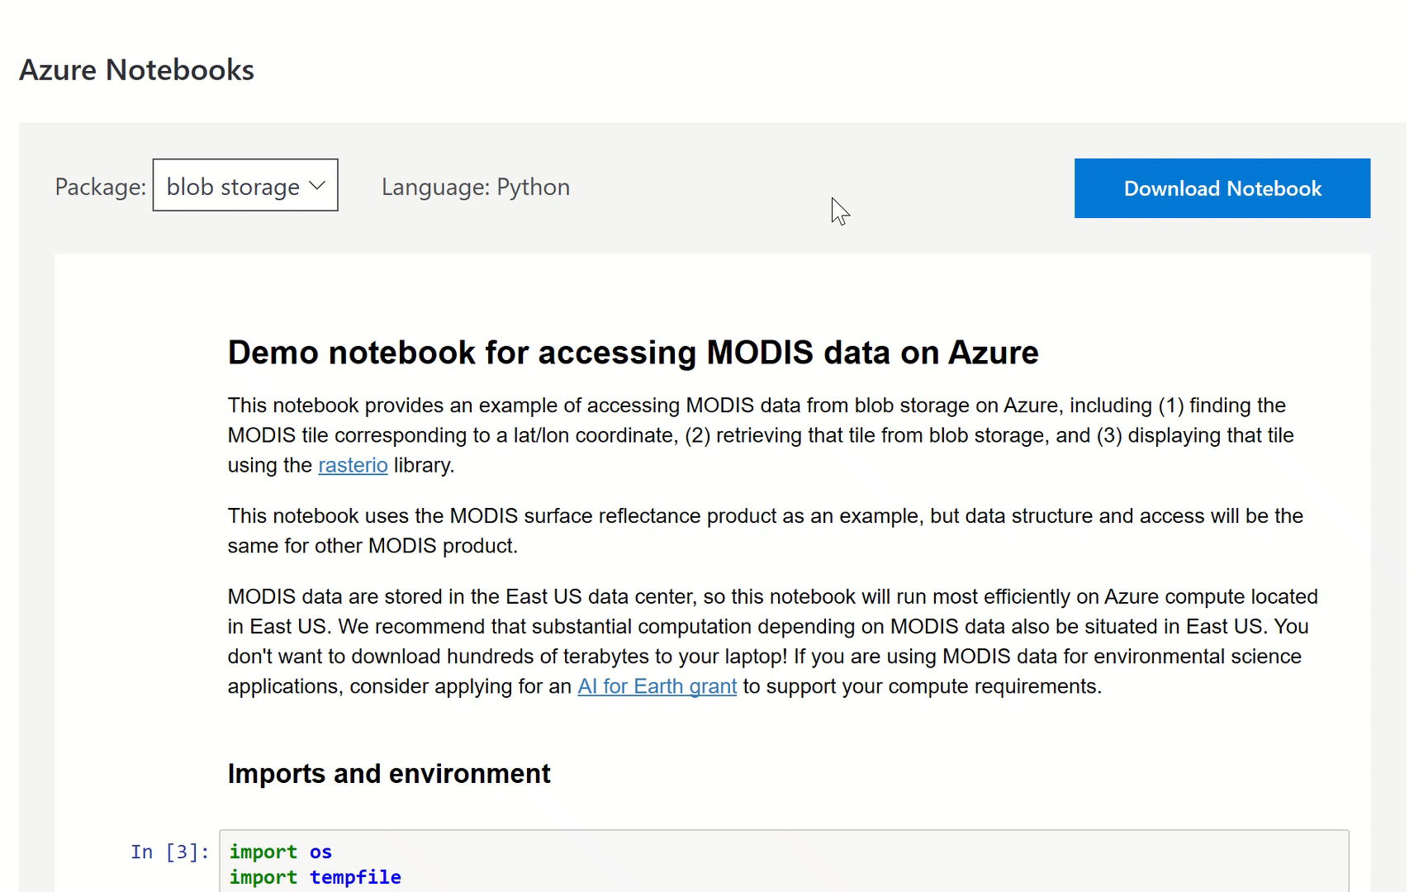
Use ready examples
Notes:
Use ready examples
[Go to VS code AzureNotebooks-blob-storage-modis.ipynb]
Then
[go to https://azure.microsoft.com/en-us/services/open-datasets/catalog/modis/ ]

Slide 12
Spatial data are special data?
Tensorflow and Pytorch are specialized Deep Learning frameworks, that are developed for specific needs. E.g. Image recognition
Things don’t go well when you try to use them outside their comfort zone.
Notes:
Spatial data are special data?
Tensorflow and Pytorch are specialized Deep Learning frameworks, that are developed for specific needs. E.g. Image recognition
Things don’t go well when you try to use them outside their comfort zone.

Slide 13

My favorite deep learning framework
Raster Vision is an open source framework for Python developers building computer vision models on satellite, aerial, and other large imagery sets (including oblique drone imagery)
https://rastervision.io/
Notes:
My favorite deep learning framework
Raster Vision is an open source framework for Python developers building computer vision models on satellite, aerial, and other large imagery sets (including oblique drone imagery)
[Go to https://rastervision.io/]

Slide 14
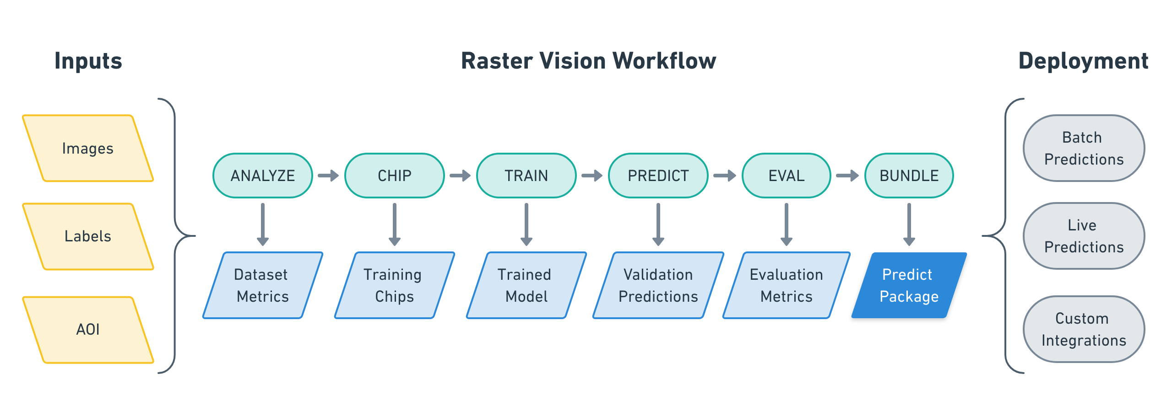
Raster-Vision workflow
Notes:
The process of running experiments includes executing workflows that perform the following commands:
ANALYZE: Gather dataset-level statistics and metrics for use in downstream processes.
CHIP: Create training chips from a variety of image and label sources.
TRAIN: Train a model using a variety of “backends” such as TensorFlow or Keras.
PREDICT: Make predictions using trained models on validation and test data.
EVAL: Derive evaluation metrics such as F1 score, precision and recall against the model’s predictions on validation datasets.
BUNDLE: Bundle the trained model into a Predict Package, which can be deployed in batch processes, live servers, and other workflows.

Slide 15
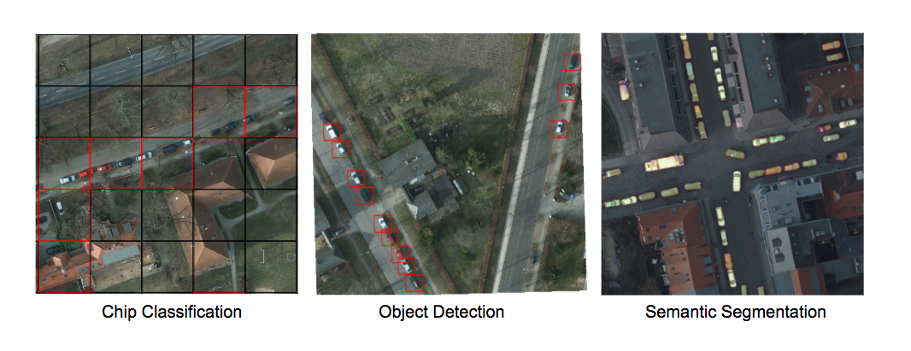
Processing power catch
CPU cost
Chip Classification < Object Detection < Semantic Segmentation
Notes:
Processing power catch
Chip classification < Object detection < Semantic classification

Slide 16
Spatial Data vs Big Data
All depends on the question:
- If you are studying (labeling) small features (e.g. roofs, cars, parking places) you are OK!!! There is nothing to worry about Big Data.
If you are studying (labeling) large features (e.g. lakes, oil spills, forests)
You are in Big (Trouble) Data!!!!
Notes:
Spatial Data vs Big Data
All depends on the question:
- If you are studying (labeling) small features (e.g. roofs, cars, parking places) you are OK!!! There is nothing to worry about Big Data.
If you are studying (labeling) large features (e.g. lakes, oil spills, forests)
You are in Big (Trouble) Data!!!!

Slide 17
The Don’t’s
Never use Windows, always Linux
Don’t use the CPU versions, always the GPU
Never run it in your local computer.
Bonus –
4. Don’t go to your supervisor for a new Alienware laptop…. ;-)
Notes:
The Don’t’s
Never use Windows, always Linux
Don’t use the CPU versions, always the GPU
Never run it in your local computer.
Bonus –
4. Don’t go to your supervisor for a new Alienware laptop…. ;-)

Slide 18
If not local, then what?
Good choice (generally) Azure Machine Learning and good match with VS Code.
If you are working in special stuff (as we always do) use Azure Batch.
Notes:
If not local, then what?
Good choice (generally) Azure Machine Learning and good match with VS Code.
If you are working in special stuff (as we always do) use Azure Batch.
Spoiler: It is too cheap 0.30Euro/hour
[Go to VS Soce to show machine Learning extension]

Slide 19
2nd step dockerize everything
//requirements.txt
azure azure-storage azure-storage-blob
#Dockerfile
FROM quay.io/azavea/raster-vision:pytorch-0.10 COPY requirements.txt / RUN pip install -r /requirements.txt
COPY tiny_spacenet.py ENV PATH=$PATH:/src ENV PYTHONPATH /src ADD ./ /src WORKDIR /src/

Slide 20
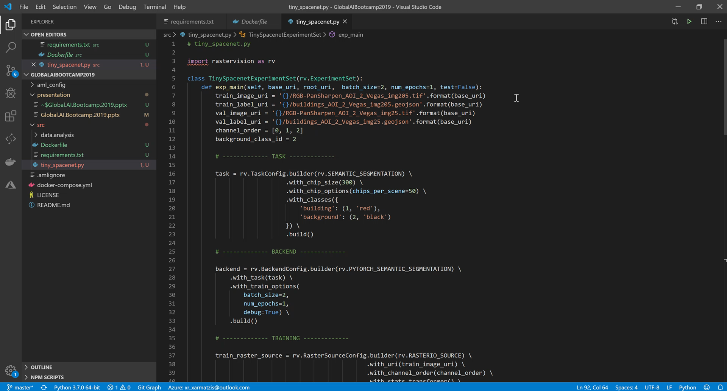
Write experiments
> python src/tiny_spacenet.py run local -- base_uri \
data --root_uri results
Notes:
Write experiments
SEMANTIC_SEGMENTATION for buildings in Las Vegas
[Go to VS code tiny_spacenet.py ]
[Go to Qgis]
Then
[Go to https://docs.rastervision.io/en/0.10/quickstart.html#seeing-results]

Slide 21
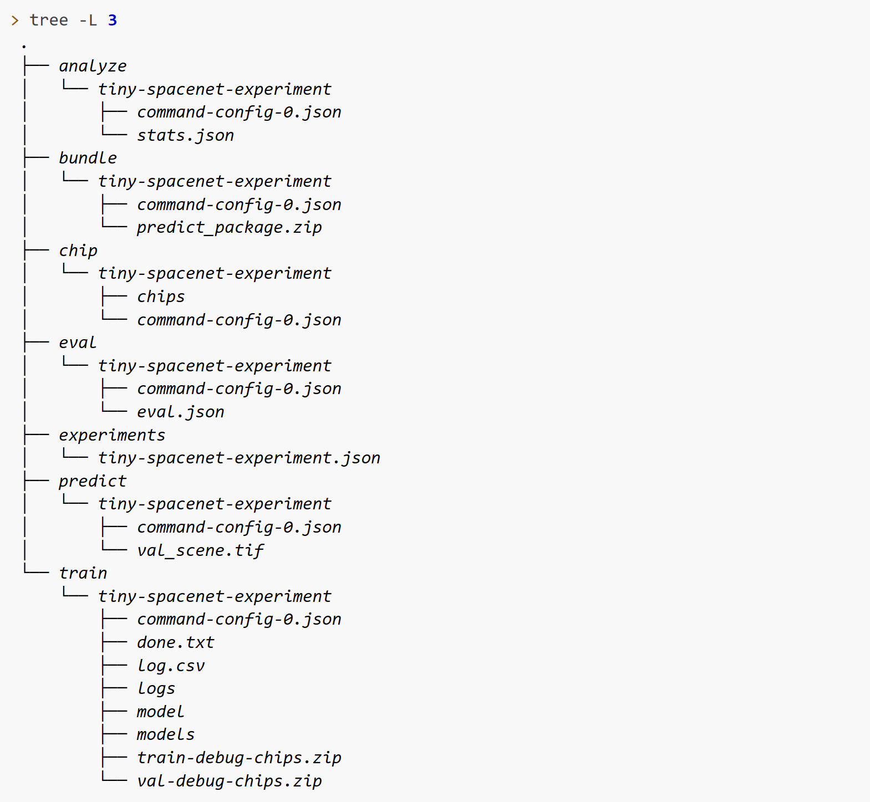
The result output
Notes:
In the bundle folder there is a predict_package.zip
Which include the features that are used for the model and the model

Slide 22
Build & run
//Build docker image
docker build -t charmatzis/raster_vision_azure_batch_demo .
//Run it
docker run charmatzis/raster_vision_azure_batch_demo python /src/tiny_spacenet.py -- base_uri
wasbs://demo@charmatzis.blob.core.windows.net/ --root_uri wasbs://demo@charmatzisdata.blob.core.windows.net/results
Notes:
Pro Tip:
Use the most simple type of storage
This means go for blog storage….
It save time!!!!

Slide 23
Move images to Azure with 3 simple moves
Azure Container Registry docker login athensaibootcampdemo.azurecr.io
Tag your docker container docker tag charmatzis/raster_vision_azure_batch_demo:latest athensaibootcampdemo.azurecr.io/charmatzis/ raster_vision_azure_batch_demo :latest
Upload it to ACR docker push athensaibootcampdemo.azurecr.io/ athensaibootcampdemo / raster_vision_azure_batch_demo :latest
Notes:
1st move
Azure Container Registry – login in your azure container resources
2nd move
Tag your docker container – tage your container in the azure container resource
3rd move
Upload it to ACR – docker push
First time it take a lot of time since it move GB to azure, then changes takes secs

Slide 24
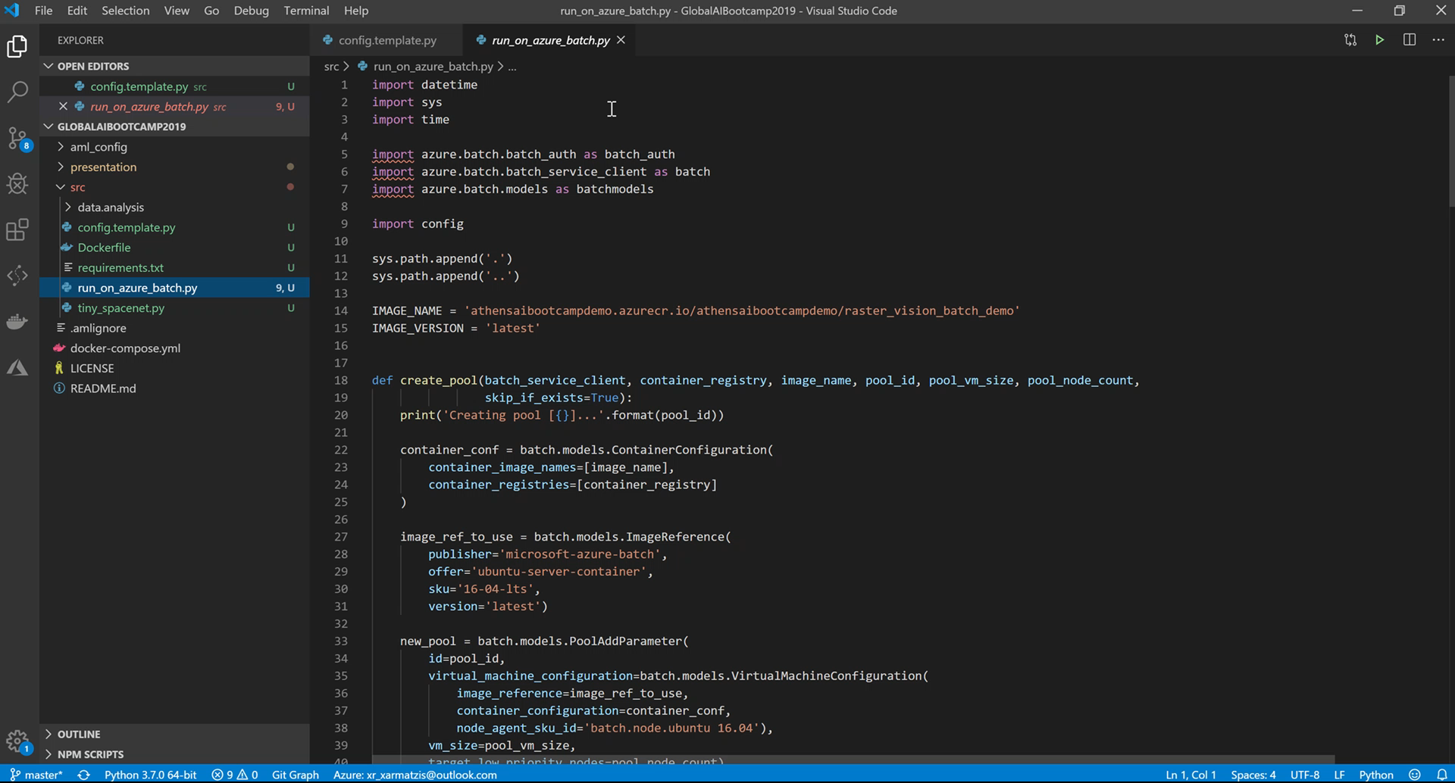
Run it on Azure Batch
Notes:
Run it on Azure Batch
Three choices
Use azure CLI
Use .Net
Use Python
We use Python
The only you need is a config file to add the credentials and a python script with the functions
- create_pool
- create_job
- add_task
wait_for_tasks_to_complete
[Go to VS code run_on_azure_batch.py]

Slide 25
Run it on Azure Batch… But how?
It connects to your container registry and uses those docker images
Create a Pool if it doesn’t exist yet. Here, you can configure which kind of VMs and how many of them you want in your pool. And more importantly, you can specify that it are Low Prio VMs, which are cheap.
Create a Job within the Pool
Create a separate task to process each year of data. In a real-life situation, you would have a task for each day of data.
Notes:
- It connects to your container registry and uses those docker images
- Create a Pool if it doesn’t exist yet. Here, you can configure which kind of VMs and how many of them you want in your pool. And more importantly, you can specify that it are Low Prio VMs, which are cheap.
- Create a Job within the Pool
- Create a separate task to process each year of data. In a real-life situation, you would have a task for each day of data.

Slide 26
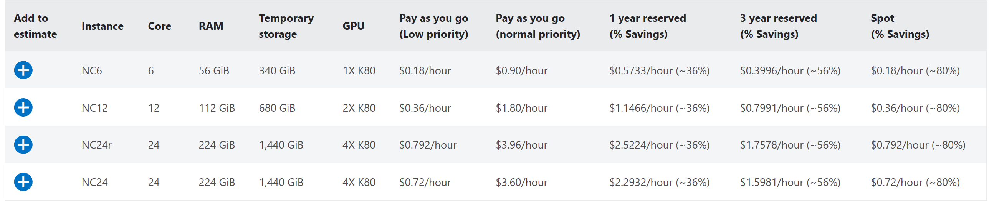
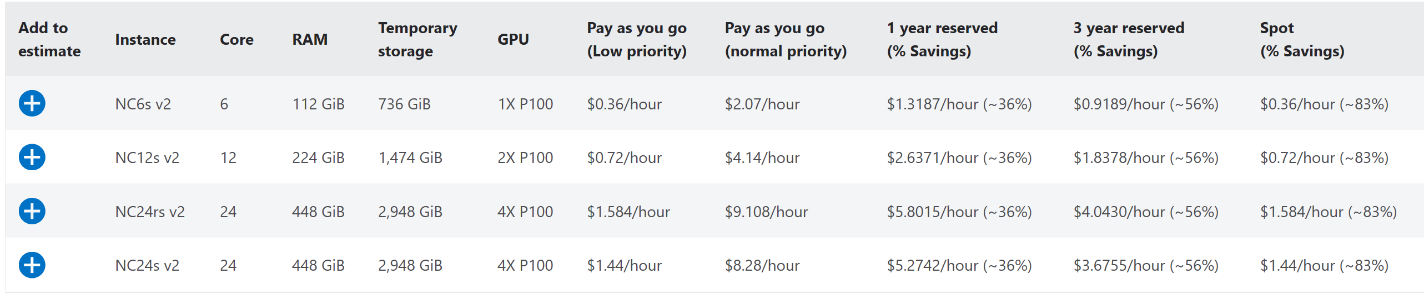
$Pricing$
https://azure.microsoft.com/en-us/pricing/details/batch/
Notes:
NC-series with K80 (up) and NCsv2-series P100 down
Starts from 0.18/hour and 0.36/hour
Low-priority VMs and Spot VMs
Azure Batch has supported low-priority VMs since 2017, but is being updated to support spot VMs. Spot VMs are very similar to low-priority VMs, but instead of a fixed price, the price can vary and a maximum price can optionally be specified to limit the price paid for spot VMs.
80% off!!!
https://azure.microsoft.com/en-us/pricing/details/batch/

Slide 27
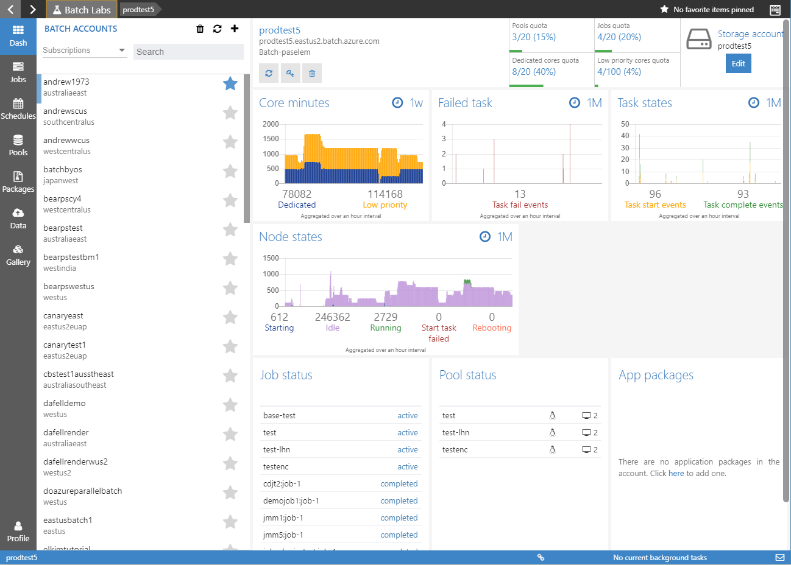
How can I monitor my Batch?
Notes:
How can I monitor my batch
Azure Batch Explorer
You can monitor

Slide 28
Conclusions
If you have normal experiments, use Azure Machine Learning
If you are working in some crazy stuff go straight to Azure Batch using containers.
Also use as simple storage as possible (Blob)
Be patient, things never work by themselves.
(Bonus)
Never, use your laptop for deep learning…
Notes:
- If you have normal experiments, use Azure Machine Learning
- If you are working in some crazy stuff go straight to Azure Batch using containers.
Also use as simple storage as possible (Blob)
Be patient, things never work by themselves.
- Never, use your laptop for deep learning…

Slide 29
Thank U & Questions
https://github.com/TA-Geoforce/GlobalAIBootcamp2019

